Slide 1
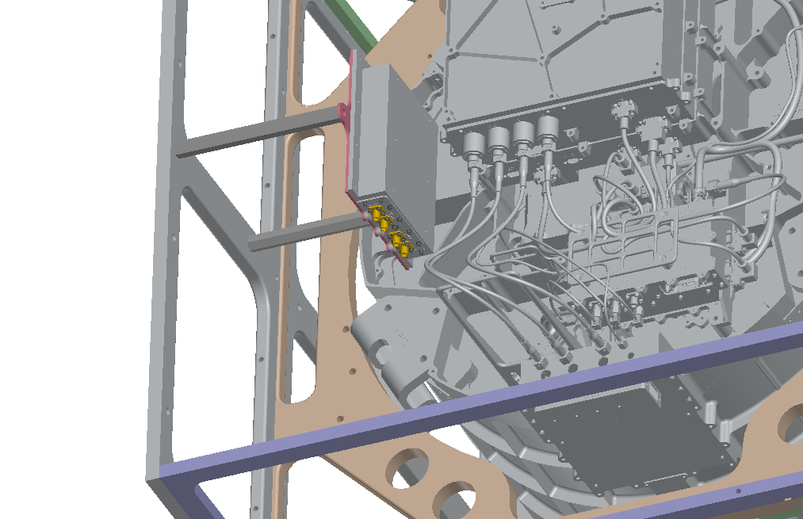
Laser and Temp Testing (Vacuum)
IE: Scott K.
ME: Chip
EE: Reid, Joel, Stacy
5/11
Laser testing hardware collected and ready for use
Plan to use 532nm – new optics to be procured
MGSE CSAs identified – Alec owning
Functional test at cold op and hot op – schedule to dictate outcome
Chamber qualification 1wk prior to test
Laser diagram – Scott
Laser/TVAC – Sam (adding thermal GSE)
Procedures to be released
Laser test set-up vacuum MGSE (Scott K.)
Harnessing for test campaign
Swap out optics tuned for 532nm and block IR (1064nm)
Review quick look python code with Ethan
What level of data are we looking at during Dust and Laser testing
Ethan to potentially add pulser stimulus to gather telemetry on instrument baseline –
What is the outgassing chamber qualification requirement – Jeff to answer
11/17/2022

Slide 2
Notes:

